Slide 1
DELEGATES IN C#

Slide 2
Objectives
Delegate
Creating a delegate
Instantiating a delegate
Calling a delegate
Anonymous method and anonymous delegate

Slide 3
Delegates and Its Advantages
Delegate is a type which holds the method(s) reference in an object. It is also referred to as a type safe function pointer.
Advantages
Encapsulating the method's call from caller
Effective use of delegate improves the performance of application
Used to call a method asynchronously

Slide 4
Declaring a Delegate
A Delegate Declaration Defines a Type That Encapsulates a Method with a Particular Set of Arguments and Return Type
// declares a delegate for a method that takes a
//single argument of type string and has a
//void return type
delegate void MyDelegate(string s);

Slide 5
Instantiating a Delegate
A Delegate Object Is Created with the new Operator
Delegate Objects Are Immutable
// instantiating a delegate to a static method
//Hello in the class MyClass
MyDelegate a = new MyDelegate(MyClass.Hello);
// instantiating a delegate to an instance method
// AMethod in object p
MyClass p = new MyClass();
MyDelegate b = new MyDelegate(p.AMethod);

Slide 6
Calling a Delegate
Use a Statement Containing:
The name of the delegate object
Followed by the parenthesized arguments to be passed to the delegate
// given the previous delegate declaration and
// instantiation, the following invokes MyClass'
// static method Hello with the parameter "World"
a("World");
Notes:
Note:
An example code on delegates:
using System;
using System.Collections.Generic;
using System.Linq;
using System.Text;
namespace SimpleDelegateExample
{
public delegate void Del(string message);
class SomeClass
{
public static void StaticDelegateMethod(string message)
{
Console.WriteLine(message);
}
public void InstanceDelegateMethod(string message)
{
Console.WriteLine(message);
}
}
class Program
{
static void Main(string[] args)
{
Del staticdelobject = new Del(SomeClass.StaticDelegateMethod);
SomeClass someobject = new SomeClass();
Del instancedelobject = new Del(someobject.InstanceDelegateMethod);
staticdelobject("Calling Static method using delegate");
instancedelobject("Calling Instance method using delegate");
}
}
}

Slide 7
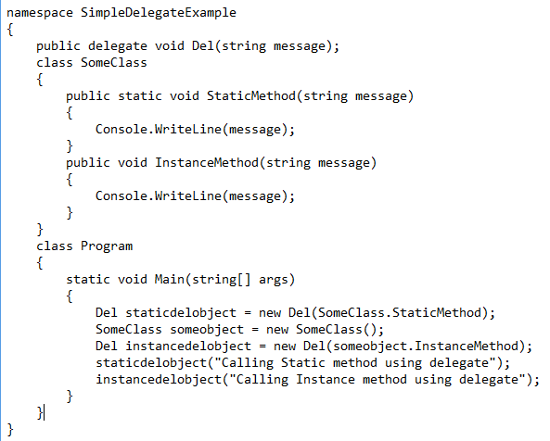
Example: Single Case Delegate

Slide 8
What is Multicast Delegate?
It is a delegate which holds the reference of more than one method.
Multicast delegates must contain only methods that return void, else there is a run-time exception.
Then the Delegate is added using the += operator and removed using the -= operator.

Slide 9
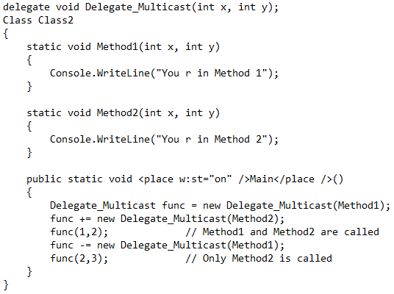
Example of Multicast delegate

Slide 10
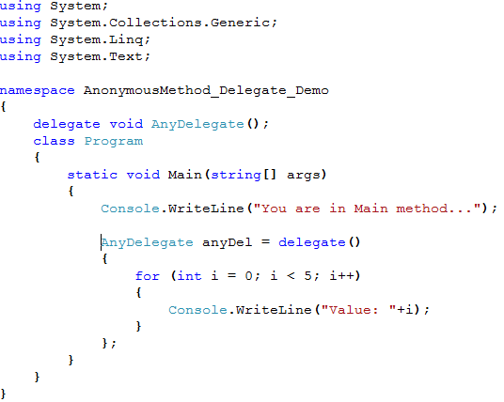
Anonymous Methods and Anonymous Delegates
Anonymous methods let you declare a method body without giving it a name.
Behind the scenes, they exist as 'normal' methods; however, there is no way to explicitly call them in your code.
Anonymous methods can only be created when using delegates and, in fact, they are created using the delegate keyword
Anonymous Delegate
Anonymous Method
Notes:
Note:
Advantage of Anonymous Method and Delegate:
Creating anonymous methods is essentially a way to pass a code block as a delegate parameter.
By using anonymous methods, you reduce the coding overhead in instantiating delegates by eliminating the need to create a separate method.

Slide 11
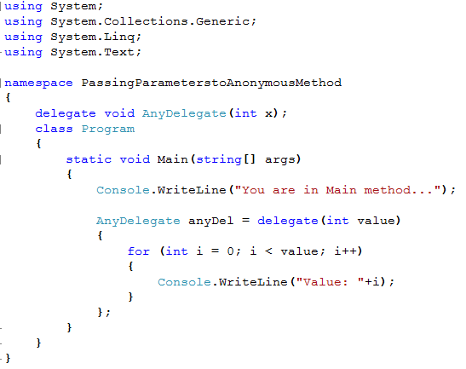
How to Pass Parameters to Anonymous Methods
The delegate is accepting a parameter that has also to be passed to the anonymous method
‘value’ is the parameter passed to anonymous method through anonymous delegate

Slide 12
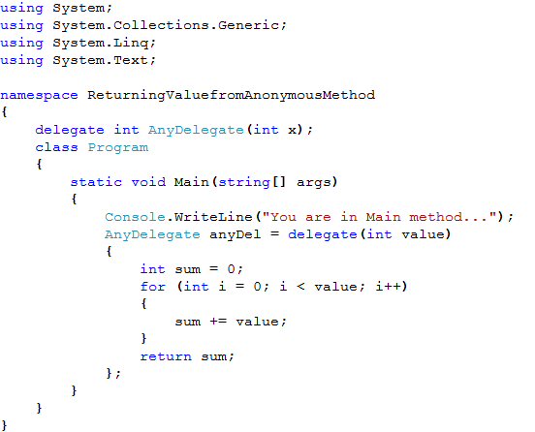
Returning Value from Anonymous Method
Return type mentioned in the delegate declaration
The variable ‘sum’ will be returned by the anonymous method

Slide 13
Reference
For further details on Delegates and it’s usage in Lambda Expressions visit
http://www.codeproject.com/Articles/47887/C-Delegates-Anonymous-Methods-and-Lambda-Expressio
For more details on Anonymous Methods you can visit this link
http://msdn.microsoft.com/en-us/library/0yw3tz5k%28v=VS.80%29.aspx
For more details on Generic Delegates, visit this web page
http://msdn.microsoft.com/en-us/library/sx2bwtw7(v=vs.80).aspx
For co-variance and contra-variance, please visit the following urls
http://en.wikipedia.org/wiki/Covariance_and_contravariance_(computer_science)
http://blogs.msdn.com/ericlippert/archive/tags/Covariance+and+Contravariance/default.aspx
Notes:
Reference

